Slide 1
Kubernetes Networking 101
By Chetan Shah

Slide 2
Kubernetes Networking

Slide 3
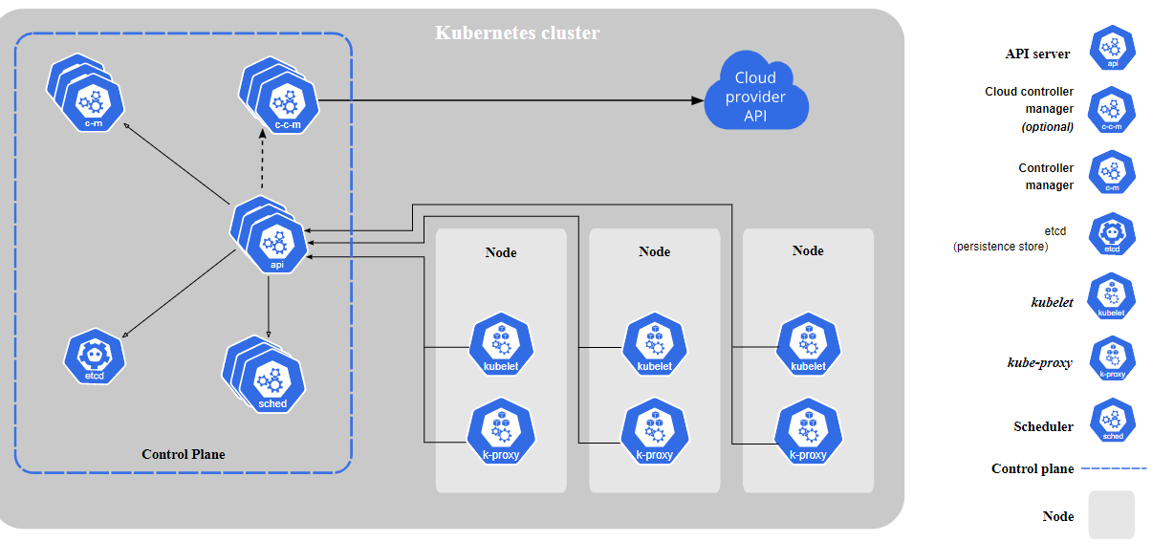
Kubernetes Architecture

Slide 4
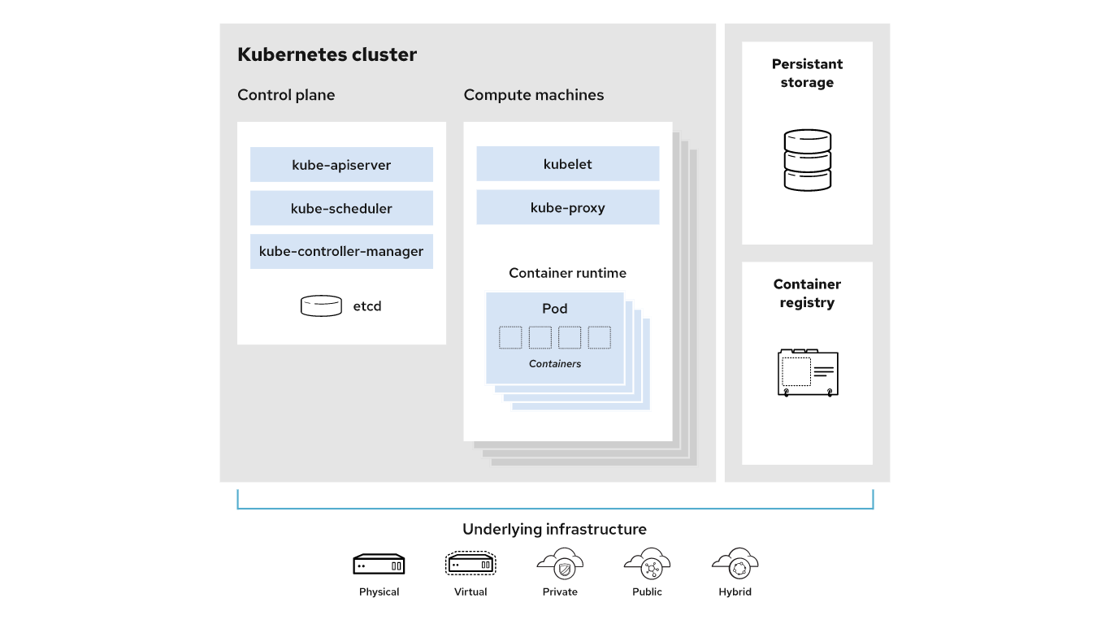

Slide 5
Kubernetes - Control Plane Components
Control Plane - The control plane's components make global decisions about the cluster (for example, scheduling), as well as detecting and responding to cluster events (for example, starting up a new pod when a deployment's replicas field is unsatisfied).
Apiserver - The API server is a component of the Kubernetes control plane that exposes the Kubernetes API. The API server is the front end for the Kubernetes control plane.

Slide 6
Kubernetes - Control Plane Components
ETCD - Consistent and highly-available key value store used as Kubernetes' backing store for all cluster data.
Scheduler - Scheduler watches for newly created Pods with no assigned node, and selects a node for them to run on. Factors taken into account for scheduling decisions include: individual and collective resource requirements, hardware/software/policy constraints, affinity and anti-affinity specifications, data locality, inter-workload interference, and deadlines.

Slide 7
Kubernetes - Control Plane Components
Controller-manager - Runs the runs controller processes.
Logically, each controller is a separate process, but to reduce complexity, they are all compiled into a single binary and run in a single process.
Some types of these controllers are:
Node controller: Responsible for noticing and responding when nodes go down.
Job controller: Watches for Job objects that represent one-off tasks, then creates Pods to run those tasks to completion.
Endpoints controller: Populates the Endpoints object (that is, joins Services & Pods).
Service Account & Token controllers: Create default accounts and API access tokens for new namespaces.

Slide 8
Kubernetes - Control Plane Components
Cloud-controller-manager - CCM embeds cloud-specific control logic.
The cloud controller manager lets you link your cluster into your cloud provider's API, and separates out the components that interact with that cloud platform from components that only interact with your cluster.
The cloud-controller-manager only runs controllers that are specific to your cloud provider. If you are running Kubernetes on your own premises, or in a learning environment inside your own PC, the cluster does not have a cloud controller manager.

Slide 9
Kubernetes - Node Components
Kubelet - An agent that runs on each node in the cluster. It makes sure that containers are running in a Pod.
Kube-proxy - kube-proxy maintains network rules on nodes. These network rules allow network communication to your Pods from network sessions inside or outside of your cluster.
Container runtime - The container runtime is the software that is responsible for running containers.Kubernetes supports several container runtimes: Docker, containerd, CRI-O, and any implementation of the Kubernetes CRI (Container Runtime Interface).

